Slide 1
Monthly Report Outline
1. Monthly Onshore ILP Mandate Wallet Share Report
(1.) Share by site – (Top 20)
(2.) Share by account – ( Top 17 , on AIA List )
(3.) Top 5 Holding Funds in ILP
2. Monthly Onshore ILP Mandate Wallet Share Report
(1.) Share by site – (Top 20)
(2.) Share by account – ( Top 27 , AIA List & 精彩網 )
(3.) Top 5 Holding Funds in ILP
3. New Issue Accounts In Current Month

Slide 2
Onshore ILP Mandate Wallet Share by SITE
Among the top 18 SITEs with onshore ILP mandate business, we have approximate 7.67% of wallet share in total. Total AUM is NTD 12,695 mn.
SITE | ILP # account | DB # account* | Contract size (TWD mn) | DB AUM | DB % | Reason for 0% wallet share
FuhHwa SITE | 24 | 19 | 69,691 | 6,856 | 9.84%
Yuanta SITE | 5 | 4 | 25,171 | 1,057 | 4.20%
Allianz SITE | 6 | 6 | 21,043 | 1,779 | 8.45%
AB SITE | 3 |  | 10,082 |  |  | No third party fund allocation
Cathay SITE | 1 |  | 7,188 |  |  | Brand name issues unresolved, but already build connection with chairman
Franklin SITE | 3 | 6 | 6,058 | 589 | 9.73%
Capital SITE | 6 | 4 | 5,822 | 1,093 | 18.77%
Manulife SITE | 3 | 4 | 5,639 | 184 | 3.26%
Fubon SITE | 3 | 2 | 4,069 | 510 | 12.54%
TCB SITE | 2 | 2 | 2,708 | 411 | 15.16%
CTBC SITE | 2 | 2 | 2,522 | 153 | 6.05%
Taishin SITE** | 2 | 1 | 1,336 |  |  | a/c opened in May. New positions are not counted in.
Pinebridge SITE | 1 |  | 1,126 |  |  | Positions temporarily redeemed for trading purpose.
Eastspring SITE | 1 | 1 | 1,027 |  |  | Mainly allocate in in-house onshore funds.
Uni-President SITE | 1 | 1 | 815 |  |  | Positions temporarily redeemed for trading purpose.
KGI SITE | 2 | 1 | 372 | 44 | 11.88%
First Securities SITE | 1 | 1 | 127 | 12 | 9.81%
ShinKong SITE | 1 | 2 | 29 | 7 | 25.19%
Total | 68 | 56 | 165,467 | 12,695 | 7.67%
Unit : NTD mn. Sorting by contract size.
Source : SITCA and SA. Data is as of June 30 *Accumulated and Monthly Income Distribution accounts would be counted in 1 account

Slide 3
Onshore ILP mandate Wallet share – Top 17 ILP contracts
We’ve penetrated all the top 17 ILP contracts and had approximate 9.61% of wallet share in total. Total AUM is NTD 9,890 mn.
Account | AUM 6/30 | DB AUM | DB %
南山人壽委託復華投信投資帳戶-新臺幣精選平衡型(現金撥回) | 49,313 | 5,776 | 11.71%
安聯人壽委託德盛安聯投信投資帳戶-台幣環球股債均衡組合(月撥回資產) | 9,773 | 1,156 | 11.83%
合作金庫人壽新臺幣環球穩健投資帳戶(委託復華投信運用操作)-轉投入 | 7,236 | 427 | 5.90%
富邦人壽委託安聯投信-優享退月提解全權委託投資帳戶(現金撥回) | 5,279 | 31 | 0.58%
三商美邦人壽鑫穩健投資帳戶(現金撥回) | 4,708 | 499 | 10.59%
*保誠人壽全權委託富蘭克林華美投信投資帳戶-新臺幣股債平衡收益帳戶 | 3,676 | 363 | 9.86%
台灣人壽委託群益投信投資帳戶-安鑫增益投資帳戶(新臺幣) | 3,007 | 496 | 16.50%
保誠人壽全權委託宏利投信投資帳戶-亞洲亮點收益帳戶 | 2,944 | 75 | 2.56%
臺銀人壽委託復華投信投資帳戶-新台幣精選平衡型 | 2,782 | 128 | 4.60%
**台灣人壽台幣代操帳戶(成長型) | 2,213 | 55 | 2.51%
安聯人壽委託復華投信投資帳戶-豐收得利2(月撥回資產) | 2,113 | 31 | 1.46%
*法國巴黎人壽新臺幣環球成長投資帳戶(委託富蘭克林華美投信運用操作) | 1,989 | 102 | 5.10%
**台灣人壽委託宏利投信-台幣投資帳戶(成長型)(二) | 1,818 | 33 | 1.82%
*安聯人壽委託富蘭克林華美投信投資帳戶_新臺幣多元收益 | 1,694 | 125 | 7.38%
全球人壽優選樂退投資帳戶 | 1,621 | 514 | 31.72%
法國巴黎人壽新臺幣全球平衡投資帳戶(委託復華投信運用操作)-月撥現 | 1,478 | 54 | 3.64%
合作金庫人壽新臺幣環球穩健投資帳戶(委託安聯投信運用操作)-轉投入 | 1,219 | 25 | 2.09%
Total | 102,864 | 9,890 | 9.61%
Unit : NTD mn. Sorting by AUM as of 2021/6/30
Source : SA. Data is as of June 30

Slide 4
Top 5 Funds of Onshore ILP contracts
Top 5 Funds by AUM size of ILP contracts are list below, and GE is the top 1 and included in 4 ILP contracts.
4 Nomura funds are included in Top 17 ILP contracts.
Fund Name | Count of contract | AUM size (NTD mn)
野村環球基金-S類型新臺幣計價 | 4 | 618,791
復華全球大趨勢基金-新臺幣 | 6 | 503,202
復華已開發國家300股票指數基金-新台幣 | 5 | 463,917
復華美元高收益債券指數基金-新臺幣A | 5 | 419,432
柏瑞全球策略高收益債券基金-I類型 | 5 | 339,284
Fund Name | Count of contract | AUM size (NTD mn)
野村環球基金-S類型新臺幣計價 | 4 | 618,791
野村全球金融收益基金 | 1 | 18,341
野村美利堅高收益債基金 | 1 | 12,159
野村環球高收益債基金 | 1 | 11,997

Slide 5
Client Net Flow
客戶歸戶 | Inflow | outflow | netflow
中國信託投信 | 152,000,000 | 42,766,800 | 109,233,200
中國信託商業銀行 | - | - | -
中華郵政股份有限公司 | 30,000,000 | - | 30,000,000
元大人壽保險股份有限公司 | 200,000,000 | 400,057,269 | - 200,057,269
元大投信 | 1,038,310,000 | 57,345,513 | 980,964,487
公務人員退休撫卹基金管理委員會 | 648,520,820 | 338,120,624 | 310,400,196
日盛投信 | 12,200,000 | 7,840,800 | 4,359,200
台灣人壽保險股份有限公司 | 180,000,000 | 220,889,333 | - 40,889,333
台灣產物保險股份有限公司 | 20,000,000 | - | 20,000,000
全球人壽保險股份有限公司 | 180,000,000 | 186,779,266 | - 6,779,266
全球證券投資顧問股份有限公司 | 17,000,000 | 37,119,265 | - 20,119,265
合作金庫人壽保險股份有限公司 | - | 46,236,658 | - 46,236,658
合庫投信 | 100,000,000 | 237,937,114 | - 137,937,114
安聯投信 | 1,487,600,000 | 346,901,481 | 1,140,698,519
宏利投信 | 4,000,000 | 129,523,062 | - 125,523,062
宏泰人壽保險股份有限公司 | 1,100,000,000 | 1,134,612,546 | - 34,612,546
和泰產物保險股份有限公司 | - | - | -
旺旺友聯產物保險股份有限公司 | - | 23,084,857 | - 23,084,857
法商法國巴黎人壽保險股份有限公司台灣分公司 | - | 48,550,723 | - 48,550,723
保德信投信 | 10,600,000 | 14,856,370 | - 4,256,370
南山人壽保險股份有限公司 | 153,000,000 | 1,242,968,530 | - 1,089,968,530
施羅德投信 | - | 79,178,943 | - 79,178,943
第一金人壽保險股份有限公司 | 60,000,000 | 101,133,288 | - 41,133,288
第一金投信 | 4,000,000 | 4,667,287 | - 667,287
凱基投信 | - | 19,335,019 | - 19,335,019
富邦人壽保險股份有限公司 | 1,696,000,000 | 1,052,814,789 | 643,185,211
富邦投信 | 405,250,000 | 10,517,902 | 394,732,098
富蘭克林華美投信 | 408,250,000 | 177,825,000 | 230,425,000
復華投信 | 2,022,713,579 | 2,177,493,381 | - 154,779,802
新光人壽保險股份有限公司 | - | 801,521,526 | - 801,521,526
新光投信 | 4,100,000 | 5,338,700 | - 1,238,700
新光產物保險股份有限公司 | 22,000,000 | 12,773,195 | 9,226,805
群益投信 | 1,546,128,472 | 1,488,292,492 | 57,835,980
臺銀人壽保險股份有限公司 | 75,000,000 | 78,665,133 | - 3,665,133
臺灣銀行股份有限公司公教保險部 | 30,000,000 | - | 30,000,000
遠雄人壽保險事業股份有限公司 | - | 300,591,817 | - 300,591,817
Total | 11,606,672,871 | 10,825,738,683 | 780,934,188

Slide 6
New Issue Account
New Issue Account In June
發行日期 | 類全委帳戶名稱 | 發行壽險公司 | 代操投信
2021-06 | 法國巴黎人壽永續佳利投資帳戶(委託霸菱投顧運用操作)-月撥現 | 法國巴黎人壽 | 霸菱投顧
2021-06 | 法國巴黎人壽永續佳利投資帳戶(委託霸菱投顧運用操作)-轉投入 | 法國巴黎人壽 | 霸菱投顧
2021-06 | 委託安聯投資帳戶─全球鑫收益成長（單位撥回） | 國泰人壽 | 安聯投信
2021-06 | 委託安聯投資帳戶－全球鑫收益成長（現金撥回） | 國泰人壽 | 安聯投信
2021-06 | 元大投信成長收益投資管理帳戶 | 新光人壽 | 元大投信
2021-06 | 國泰主流趨勢全權委託管理帳戶(美元)(現金撥回) | 中國人壽 | 國泰投信
2021-06 | 國泰主流趨勢全權委託管理帳戶(美元)(單位撥回) | 中國人壽 | 國泰投信

Slide 7
1.) Ins 客戶歸戶.py 2.) AIA_DB_Mapping.py 3.) Account_Holding_Ana.py 4.) Top 49 全委帳戶.xlsx → Manually
Python Program & Excel

Slide 8
Ins 客戶歸戶.py
Onshore ILP Mandate Wallet
(1.) Share by site – (Top 20)
(2.) Share by account – ( Top 49 , on/off AIA List )
(3.) Detail Account Excel Sheet – (channel , customer , account , fund type … etc)
Offshore ILP Mandate Wallet
(1.) Share by site – (Top 15)
(2.) Share by account – ( Top 49, on/off AIA List )
(3.) Detail Account Excel Sheet – (channel , customer , account , fund type … etc)

Slide 9
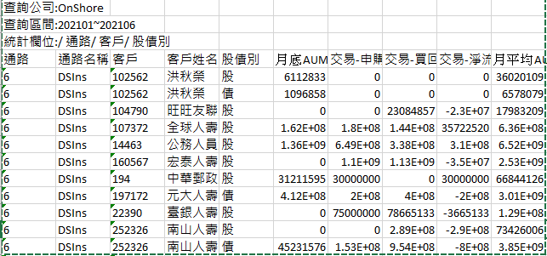
Ins 客戶歸戶.py → Input
DS Onshore/Offshore → Money
1. 客戶/基金 歸戶
2. ILP Mandate Wallet
Share by Site
3. ILP Mandate Wallet
Share by Account
4. New Issue Account

Slide 10
Onshore ILP Mandate Wallet Share by SITE
Among the top 19 SITEs with ILP mandate business listed in AIA meeting, we have approximate 7% of wallet share in total. Total AUM is NTD 10,959 mn.
AIA List
 | SITE | # of account | Contract size (TWD mn) | DB AUM (as of June) | DB % | Reason for 0% wallet share
1 | Fuh Hwa SITE | 24 | 68,979 | 7,009 | 10%
2 | Allianz SITE | 6 | 19,557 | 1,165 | 6%
3 | Yuanta SITE | 4 | 15,028 | 6 | 0%
4 | AB SITE | 3 | 9,703 | 0 | 0% | No third party fund allocation
5 | Franklin SITE | 3 | 6,043 | 521 | 9%
6 | Cathay SITE | 1 | 5,815 | 0 | 0% | Brand name issues unresolved, but already build connection with chairman
7 | Capital SITE | 6 | 5,666 | 965 | 17%
8 | Manulife SITE | 3 | 5,661 | 180 | 3%
9 | Fubon SITE | 3 | 3,715 | 505 | 14%
10 | TCB SITE | 2 | 2,774 | 403 | 15%
11 | CTBC SITE | 2 | 2,687 | 150 | 6%
12 | Pinebridge SITE | 1 | 1,160 | 0 | 0% | Positions temporarily redeemed for trading purpose.
13 | Eastspring SITE | 1 | 1,072 | 0 | 0% | Mainly allocate in in-house onshore funds.
14 | Uni-President SITE | 1 | 970 | 0 | 0% | Positions temporarily redeemed for trading purpose.
15 | Schroders SITE | 2 | 693 | 0 | 0% | No third party fund allocation
17 | KGI SITE | 2 | 409 | 43 | 11%
18 | First Securities SITE | 1 | 128 | 12 | 9%
19 | Taishin SITE | 2 | 64 | 0 | 0% | a/c opned in May. New positions are not counted in.
Total |  |  | 150,124 | 10,959 | 7%
Web Data(公會)
SA Data
Unit : TWD mn. Sorting by contract size.
Source : SA. Data is as of June 9. FX rate:28.
Notes:
Contract size → ( 投信投顧公會資料 )

Slide 11
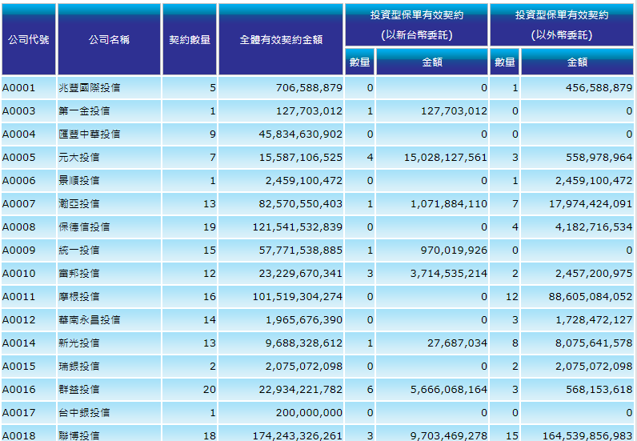


Web Data – (公會)
Select Date

Slide 12
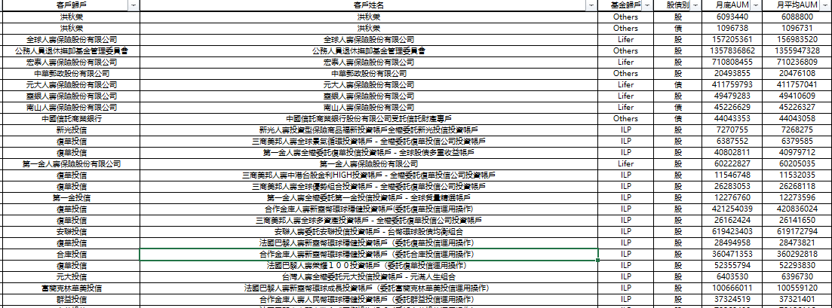
Detail Account Excel Sheet - (SA data)
依客戶拆報表
(客戶歸戶)
ILP
(基金歸戶)
月底AUM相加
DB AUM

Slide 13
Onshore ILP Mandate Wallet Share by SITE
公司名稱 | 投資型保單有效契約-數量(新台幣) | 投資型保單有效契約-金額(新台幣) | DB AUM | DB %
復華投信 | 24 | 68,978,968,702 | 7,009,105,494 | 10.16
安聯投信 | 6 | 19,556,694,110 | 1,165,622,550 | 5.96
元大投信 | 4 | 15,028,127,561 | 6,403,530 | 0.04
聯博投信 | 3 | 9,703,469,278 | - | 0
富蘭克林華美投信 | 3 | 6,043,052,262 | 521,189,903 | 8.62
國泰投信 | 1 | 5,814,655,590 | - | 0
群益投信 | 6 | 5,666,068,164 | 965,270,841 | 17.04
宏利投信 | 3 | 5,661,145,319 | 180,673,747 | 3.19
富邦投信 | 3 | 3,714,535,214 | 505,095,109 | 13.6
合庫投信 | 2 | 2,774,032,982 | 403,526,972 | 14.55
中國信託投信 | 2 | 2,687,142,770 | 150,159,228 | 5.59
柏瑞投信 | 1 | 1,159,530,789 | - | 0
瀚亞投信 | 1 | 1,071,884,110 | - | 0
統一投信 | 1 | 970,019,926 | - | 0
施羅德投信 | 2 | 692,937,726 | - | 0
野村投信 | 1 | 646,468,265 | - | 0
凱基投信 | 2 | 408,681,708 | 43,443,478 | 10.63
第一金投信 | 1 | 127,703,012 | 12,276,760 | 9.61
台新投信 | 2 | 64,276,516 | - | 0
新光投信 | 1 | 27,687,034 | 7,270,755 | 26.26
Reason
Web Data
SA Data

Slide 14
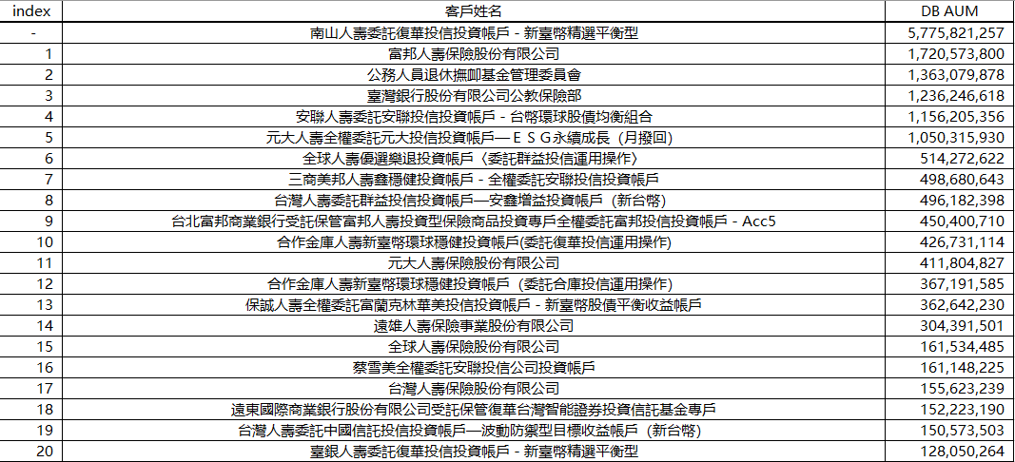
ILP Mandate Wallet Share by Account
DS Data AUM Share By Account
→ Total Account’s AUM will be fetch by the account monthly review manually

Slide 15
Monthly Manually address Account – Top 49 全委帳戶.xlsx
Total Of Account
1. Top 10 精彩網 ILP AUM Accounts
2. Onshore AIA List 17 Accounts
Total of 49 Accounts
3. Offshore AIA List 22 Accounts
Account Current AUM
From | Account | 目前規模(月報寫法) | 目前規模(新台幣)
AIA List (onshore) | 南山人壽委託復華投信投資帳戶-新臺幣精選平衡型(現金撥回) | 493.13 億元 | 49,313
Account Holding- Top 5 Holding Funds
top holding-1 | 百分比 | top holding-2 | 百分比
野村環球基金-S類型新臺幣計價 | 8.44 | 復華全球大趨勢基金-新臺幣 | 8.25
top holding-3 | 百分比 | top holding-4 | 百分比 | top holding-5 | 百分比 | Top 5 百分比加總
復華已開發國家300股票指數基金-新台幣 | 6.27 | 復華美元高收益債券指數基金-新臺幣A | 5.8 | 柏瑞全球策略高收益債券基金-I類型 | 4.82 | 33.58

Slide 16
AIA_DB_Mapping.py → Mapping
Account | AUM 6/30 | DB AUM | DB %
南山人壽委託復華投信投資帳戶-新臺幣精選平衡型(現金撥回) | 49,313 | 5,776 | 11.71%
安聯人壽委託德盛安聯投信投資帳戶-台幣環球股債均衡組合(月撥回資產) | 9,773 | 1,156 | 11.83%
合作金庫人壽新臺幣環球穩健投資帳戶(委託復華投信運用操作)-轉投入 | 7,236 | 427 | 5.90%
富邦人壽委託安聯投信-優享退月提解全權委託投資帳戶(現金撥回) | 5,279 | 31 | 0.58%
三商美邦人壽鑫穩健投資帳戶(現金撥回) | 4,708 | 499 | 10.59%
*保誠人壽全權委託富蘭克林華美投信投資帳戶-新臺幣股債平衡收益帳戶 | 3,676 | 363 | 9.86%
台灣人壽委託群益投信投資帳戶-安鑫增益投資帳戶(新臺幣) | 3,007 | 496 | 16.50%
保誠人壽全權委託宏利投信投資帳戶-亞洲亮點收益帳戶 | 2,944 | 75 | 2.56%
臺銀人壽委託復華投信投資帳戶-新台幣精選平衡型 | 2,782 | 128 | 4.60%
**台灣人壽台幣代操帳戶(成長型) | 2,213 | 55 | 2.51%
安聯人壽委託復華投信投資帳戶-豐收得利2(月撥回資產) | 2,113 | 31 | 1.46%
*法國巴黎人壽新臺幣環球成長投資帳戶(委託富蘭克林華美投信運用操作) | 1,989 | 102 | 5.10%
**台灣人壽委託宏利投信-台幣投資帳戶(成長型)(二) | 1,818 | 33 | 1.82%
*安聯人壽委託富蘭克林華美投信投資帳戶_新臺幣多元收益 | 1,694 | 125 | 7.38%
全球人壽優選樂退投資帳戶 | 1,621 | 514 | 31.72%
法國巴黎人壽新臺幣全球平衡投資帳戶(委託復華投信運用操作)-月撥現 | 1,478 | 54 | 3.64%
合作金庫人壽新臺幣環球穩健投資帳戶(委託安聯投信運用操作)-轉投入 | 1,219 | 25 | 2.09%
Total | 102,864 | 9,890 | 9.61%
ILP Mandate Onshore Share by account – ( 17 on AIA List )
Unit : NTD mn. Sorting by AUM as of 2021/6/30
Source : SA. Data is as of June 30

Slide 17
Account_Holding_Ana.py → Analysis
Top 5 Funds by AUM size of ILP contracts are list below, and GE is the top 1 and included in 4 ILP contracts.
4 Nomura funds are included in Top 17 ILP contracts.
Fund Name | Count of contract | AUM size (NTD mn)
野村環球基金-S類型新臺幣計價 | 4 | 618,791
復華全球大趨勢基金-新臺幣 | 6 | 503,202
復華已開發國家300股票指數基金-新台幣 | 5 | 463,917
復華美元高收益債券指數基金-新臺幣A | 5 | 419,432
柏瑞全球策略高收益債券基金-I類型 | 5 | 339,284
Fund Name | Count of contract | AUM size (NTD mn)
野村環球基金-S類型新臺幣計價 | 4 | 618,791
野村全球金融收益基金 | 1 | 18,341
野村美利堅高收益債基金 | 1 | 12,159
野村環球高收益債基金 | 1 | 11,997

Slide 18
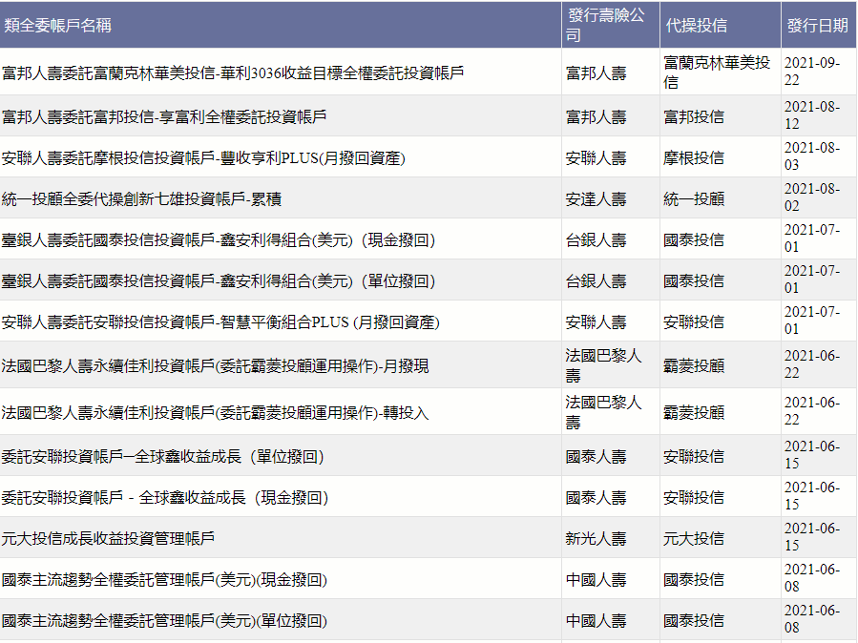
Ins 客戶歸戶.py → New Issue Account (精彩網)

